Slide 1


Advanced Computer Architecture Fall 2019
Hamed Farbeh
farbeh@aut.ac.ir
Department of Computer Engineering
Amirkabir University of Technology
Lecture 5

Slide 2
Copyright Notice
Lectures adopted from
Computer Architecture: A Quantitative Approach, 5th edition, John L. Hennessy,‎ David A. Patterson, MK pub., 2019
Advanced Computer Architecture-Spring 2018, AUT, Tehran, Iran

Slide 3
Computer Architecture
A Quantitative Approach, Sixth Edition
Chapter 3
Instruction-Level Parallelism and Its Exploitation

Slide 4
Dynamic Scheduling
Dynamic Scheduling
Rearrange order of instructions to reduce stalls while maintaining data flow
Advantages:
Compiler doesn’t need to have knowledge of microarchitecture
Handles cases where dependencies are unknown at compile time
Disadvantage:
Substantial increase in hardware complexity
Complicates exceptions

Slide 5
Dynamic Scheduling
Dynamic Scheduling
Dynamic scheduling implies:
Out-of-order execution
Out-of-order completion
Example 1:
fdiv.d f0,f2,f4
fadd.d f10,f0,f8
fsub.d f12,f8,f14
fsub.d is not dependent, issue before fadd.d

Slide 6
Dynamic Scheduling
Dynamic Scheduling
Example 2:
fdiv.d f0,f2,f4
fmul.d f6,f0,f8
fadd.d f0,f10,f14
fadd.d is not dependent, but the antidependence makes it impossible to issue earlier without register renaming

Slide 7
Register Renaming
Dynamic Scheduling
Example 3:
fdiv.d f0,f2,f4
fadd.d f6,f0,f8
fsd f6,0(x1)
fsub.d f8,f10,f14
fmul.d f6,f10,f8
name dependence with f6
antidependence
antidependence

Slide 8
Register Renaming
Dynamic Scheduling
Example 3:
fdiv.d f0,f2,f4
fadd.d S,f0,f8
fsd S,0(x1)
fsub.d T,f10,f14
fmul.d f6,f10,T
Now only RAW hazards remain, which can be strictly ordered

Slide 9
Out of Order with Scoreboard
Dynamic Scheduling
All instructions pass through the issue stage in order
Can be stalled or bypass each other in the second stage
Scoreboarding
Allowing instructions to execute out of order when there are sufficient resources and no data dependences
The scoreboard takes full responsibility for instruction issue and execution, including all hazard detection
Multiple functional units
Pipelined functional units

Slide 10
Out of Order with Scoreboard
Dynamic Scheduling
The scoreboard determines when the instruction can read its operands and begin execution
It monitors every change in the hardware
Scoreboard controls when an instruction can write its result into the destination register
All hazard detection and resolution are centralized in the scoreboard

Slide 11
Out of Order with Scoreboard
Dynamic Scheduling
Instruction steps in Scoreboard
Issue (structural and WAW hazards)
If a functional unit for the instruction is free and no other active instruction has the same destination register
Read operands (RAW hazard)
Monitors the availability of the source operands
Execution
Begins execution upon receiving operands and notifies the scoreboard when the result is ready
Write result
Checks for WAR hazards and stalls the completing instruction, if necessary

Slide 12
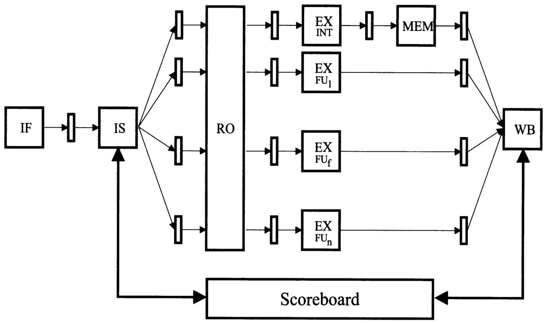
Out of Order with Scoreboard
Dynamic Scheduling

Slide 13
Out of Order with Scoreboard
Dynamic Scheduling
Scoreboarding is a single-issue scheme
A WAW or a structural hazard (an unavailable FU) prevent proceeding the instruction from the IS to the RO stage
No other instruction can be issued (an in-order issue scheme)
A RAW hazard prevents an instruction proceeding from the RO to the EX stage
A WAR hazard prevents result write-back
After the issue to the FU, the FU is blocked until the instruction is dispatched and execution starts

Slide 14
OOO Exe with Tomasulo
Dynamic Scheduling
Tomasulo’s Approach
Tracks when operands are available
Introduces register renaming in hardware
Minimizes WAW and WAR hazards
The technique that dynamically eliminates name dependences to avoid WAR and WAW hazards is called register renaming
The centralized scoreboard is replaced with distributed control within the processor
Register renaming is provided by reservation stations (RS)
Contains:
The instruction
Buffered operand values (when available)
Reservation station number of instruction providing the operand values

Slide 15
Register Renaming
Dynamic Scheduling
RS fetches and buffers an operand as soon as it becomes available (not necessarily involving register file)
Pending instructions designate the RS to which they will send their output
Result values broadcast on a result bus, called the common data bus (CDB)
Only the last output updates the register file
As instructions are issued, the register specifiers are renamed with the reservation station
May be more reservation stations than registers
Load and store buffers
Contain data and addresses, act like reservation stations

Slide 16
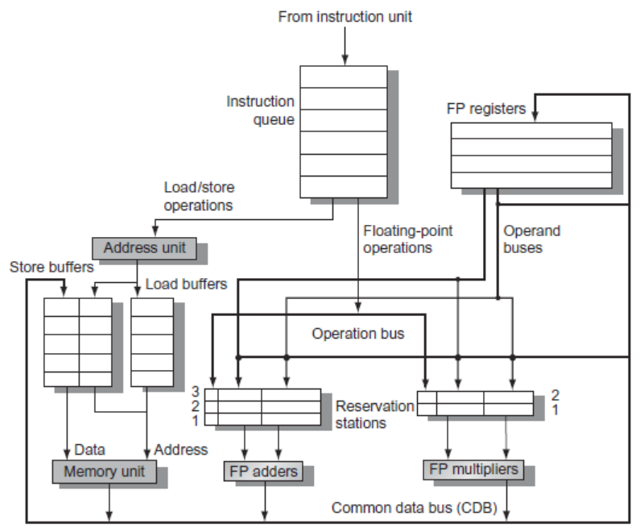
Tomasulo’s Algorithm
Dynamic Scheduling

Slide 17
Tomasulo’s Algorithm
Dynamic Scheduling
Three Steps:
Issue
Get next instruction from FIFO queue
If available RS, issue the instruction to the RS with operand values if available
If operand values not available, stall the instruction
Execute
When operand becomes available, store it in any reservation stations waiting for it
When all operands are ready, issue the instruction
Loads and store maintained in program order through effective address
No instruction allowed to initiate execution until all branches that proceed it in program order have completed
Write result
Write result on CDB into reservation stations and store buffers
(Stores must wait until address and value are received)

Slide 18
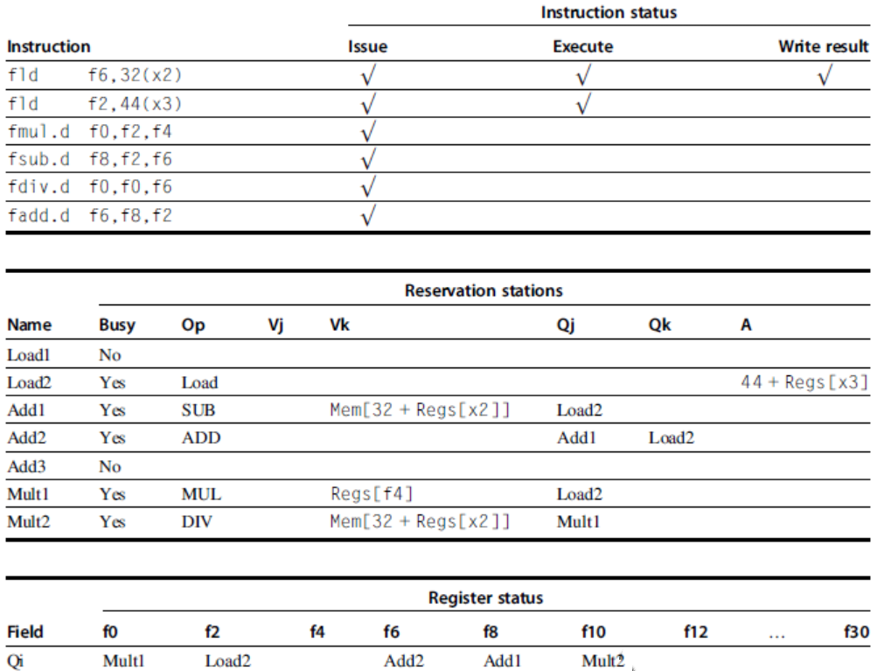
Example
Dynamic Scheduling

Slide 19
Tomasulo’s Algorithm
Dynamic Scheduling
Example loop:
Loop: fld f0,0(x1)
fmul.d f4,f0,f2
fsd f4,0(x1)
addi x1,x1,8
bne x1,x2,Loop // branches if x16 != x2

Slide 20
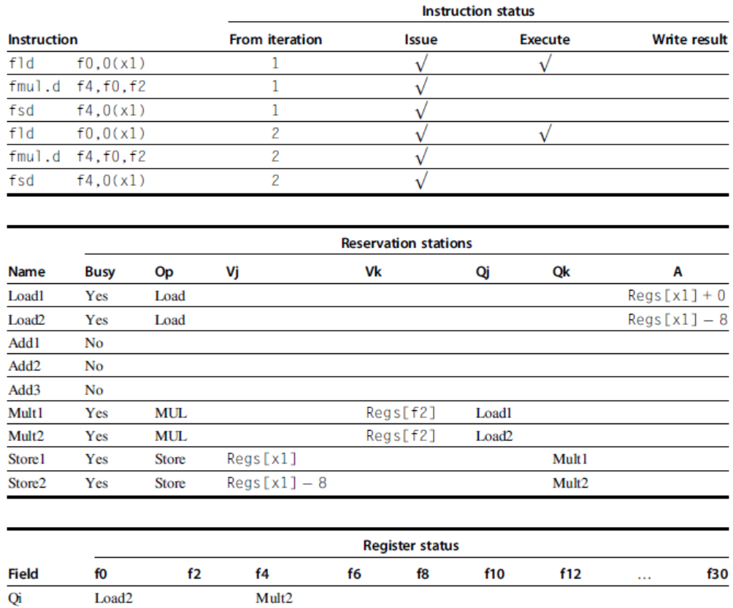
Tomasulo’s Algorithm
Dynamic Scheduling

Slide 21
Tomasulo vs. Scoreboard
In-order issue
Scoreboard is stalled on WAW and WAR
Operand forwarding in Tomasulo
Hardware complexity of Tomasulo
Dynamic Scheduling

